Slide 1


Presentation on Personal Health Records
Presented by-
Rukonuzzaman Topu
Presented to-
Md. Parvez Hossain
Lecturer Dept. Of CSE
This Photo by Unknown Author is licensed under CC BY-SA

Slide 2
01
INTRODUCTION
02
MOTIVATION
03
AIMS
CONTENTS
04
TOOLS & TECHNOLOGIES
05
CODE
06
APLICATIONS & LIMITATIONS
07
CONCLUSION

Slide 3
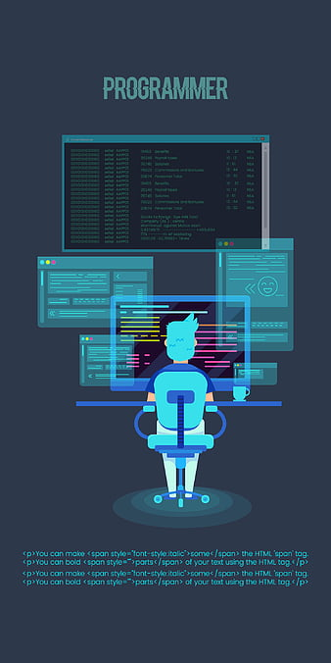
Introduction
The Personal Health Tracker helps individuals manage their health by tracking water intake, exercise, sleep, and weight. It allows users to set goals, monitor progress, and receive reminders. Using data structures like linked lists and stacks, its provides an easy and effective way to maintain a healthy lifestyle.

Slide 4

MOTIVATIONS
Understanding Needs
Design and Development
Implementation and Optimization

Slide 5

AMIS
Daily Health Metrics Tracking
Undo Feature
Notifications

Slide 6

TOOLS AND TECHNOLOGIES
Visual Studio Code
GCC (GNU Compiler Collection)
C/C++ extension

Slide 7
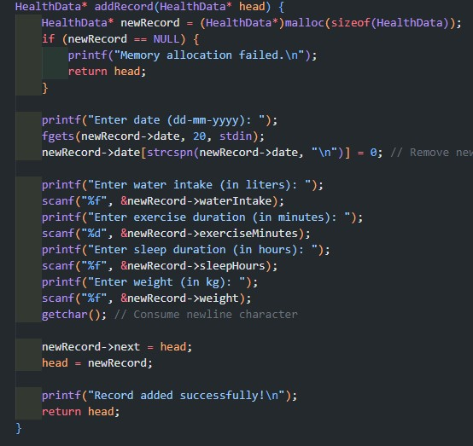
Add Health record

Slide 8
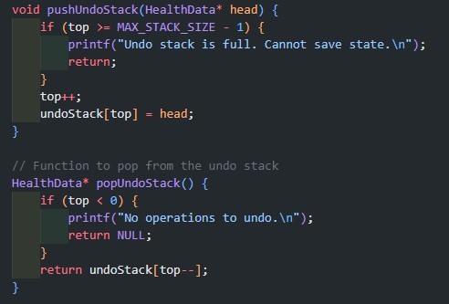
Undo Feature

Slide 9
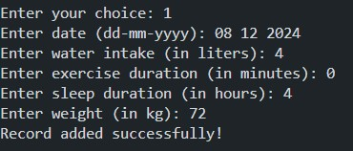
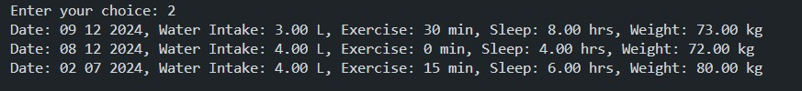
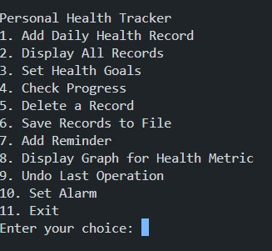

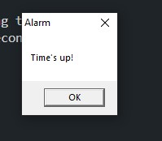
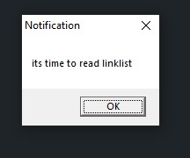
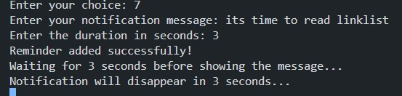
OUTPUT

Slide 10

Limitations
User Interface
Maintainability

Slide 11

The Personal Health Tracker helps users manage health through goal-setting, reminders, and efficient data structures for better outcomes.

Slide 12
THANK YOU
12

